Slide 1
What can O₂ tell us about the climate change in the oceans?
Taka Ito
taka.ito@eas.gatech.edu
School of Earth and Atmospheric Sciences
Georgia Institute of Technology

Slide 2
Global oxygen cycle
How would CO₂ respond to these processes?
Notes:
Basic processes controlling O2 in the atm/ocean.

Slide 3
CO₂ and O₂ : Yin and Yang
Between ocean and atmosphere, which one is the dominant reservoir of oxygen?
  O₂: 0.5% ocean vs 99.5% atmosphere
How about carbon dioxide?
  CO₂: 98% ocean vs 2% atmosphere
Notes:
More CO2 in the water because CO2 is an acid and the PH of water is around 8 enhancing the dissolution

Slide 4
Why study oxygen cycling?
O₂ controls many chemical reactions in the seawater and seafloor sediment
O₂ is essential for life
O₂ may inform us about changes in ecosystem and ocean circulation

Slide 5
Photosynthesis and respiration
In a very approximate form,
  Photosynthesis:
    Sun-lit surface ocean
    Sink for carbon, source for oxygen
  Respiration:
    Happening throughout water column
    Sink for oxygen, source for carbon

Slide 6
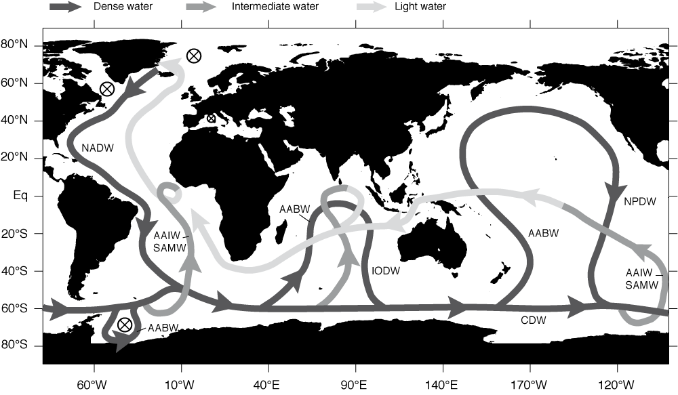
Global ocean circulation
Sarmiento and Gruber (2006)

Slide 7
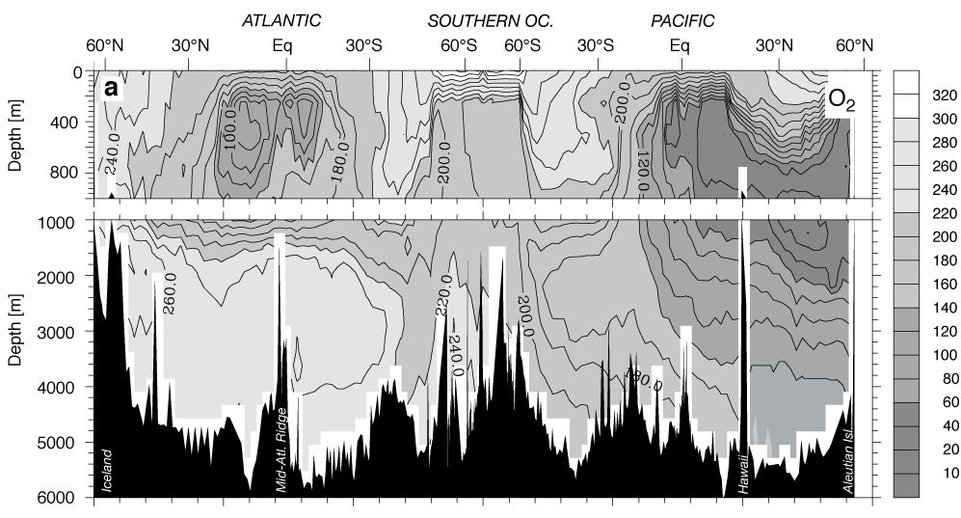
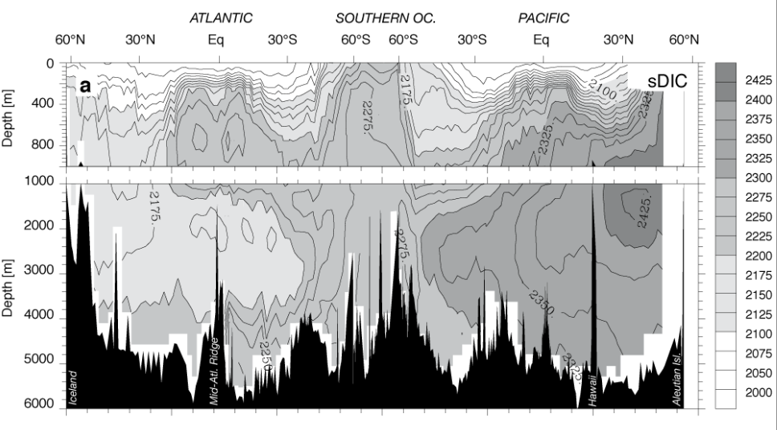
Inter-basin contrast
“Young” North Atlantic Deep Water is high in O₂ and low in DIC
“Old” North Pacific Deep Water is low in O₂ and high in CO₂
Upwelling regions have particularly low O₂ and high CO₂
Sarmiento and Gruber (2006)

Slide 8
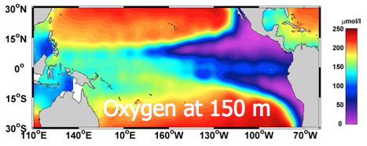
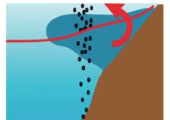
Tropical Pacific Oxygen Minimum Zone
Upwelling region
  Transport of low O₂ water from below
  Upwelling provides nutrients for photosynthesis
  Biological O₂ consumption in the thermocline

Slide 9
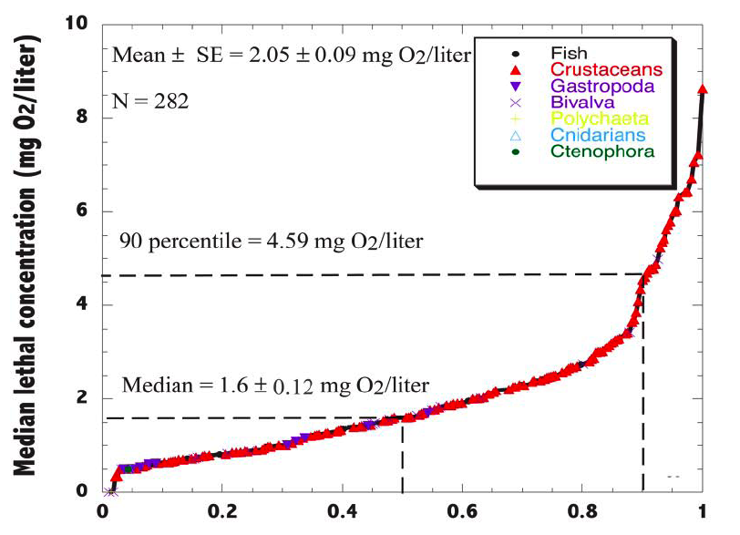
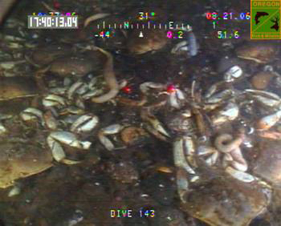
Impacts on coastal ecosystems
Aug 2006
Fraction of living organisms
Vacquer-Sunyer and Duarte [2008]
Image from an ROV off the Oregon coast
Mortality rapidly increases at the hypoxic condition
(Hypoxic = 60 μmol/kg)
Notes:
Crustaceans = shrimp, crabs, krills, etc
Gastropoda = snails
Bivalva = sea shells

Slide 10
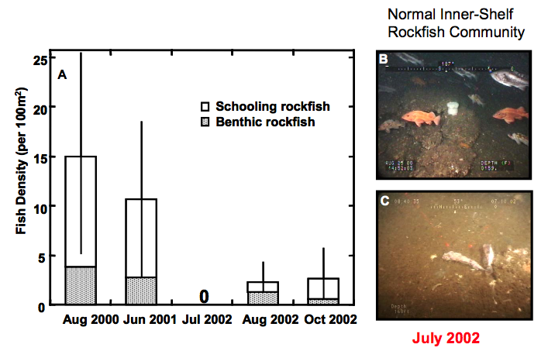
Hypoxic event in Oregon coast, 2002
Grantham et al (2004)
What are the possible causes of low oxygen events?

Slide 11
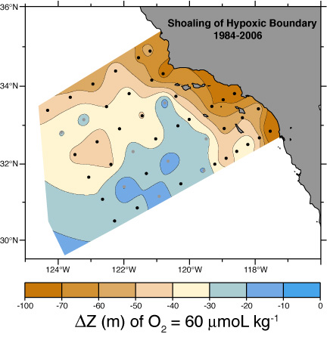
Is the ocean losing oxygen?
Last 30 years in California coast
  Reason for the growing
  low O₂ region is not fully
  Understood
  Expansion of low-O₂
  habitat a concern
Bograd et al. (2008)

Slide 12
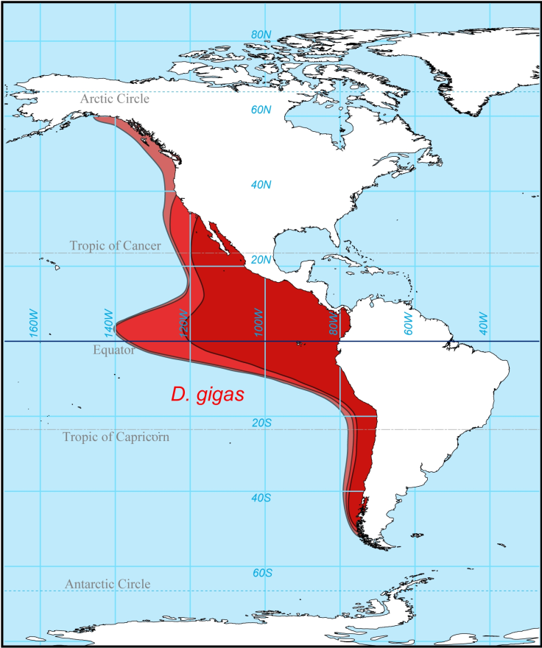
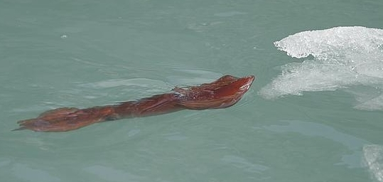
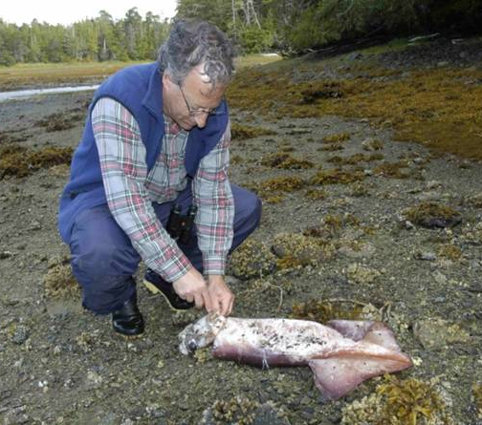
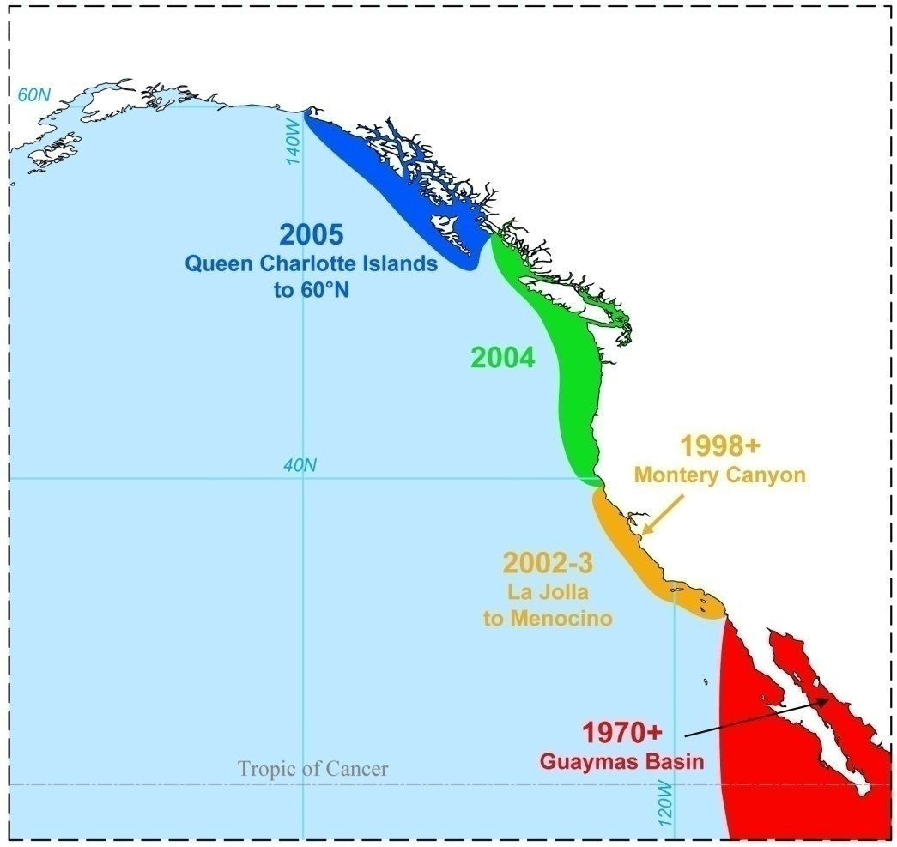
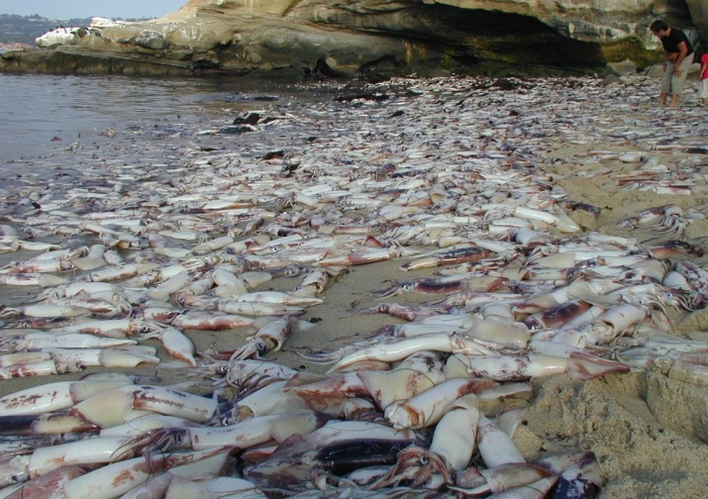
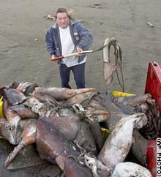
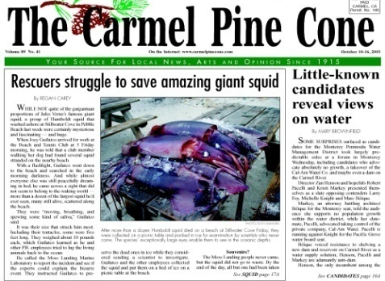
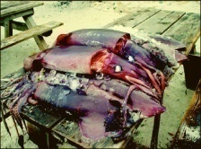
An example: Expansion of Dosidicus gigas habitat in 2000s
2004
2001
1984
July 2005
Tracy Arm (Sitka), AK
2004
Outer Coast, BC
La Jolla Cove, CA.
July, 2002
British Columbia
Sept. 2005
Long Beach, WA
Oct 2004

Slide 13
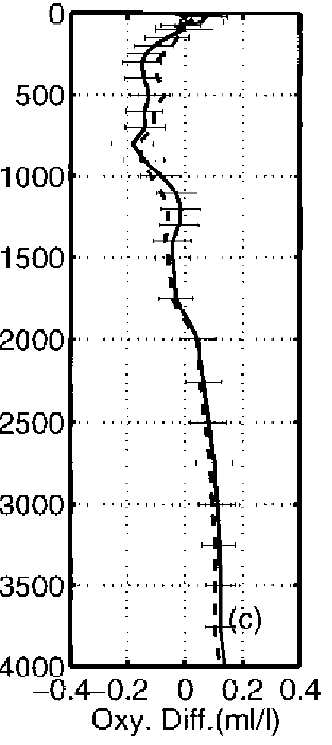
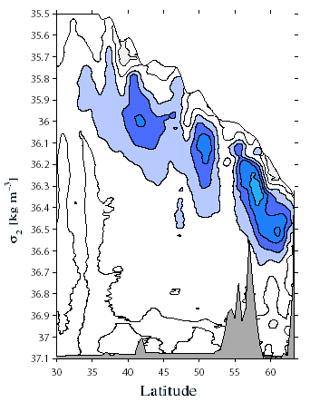
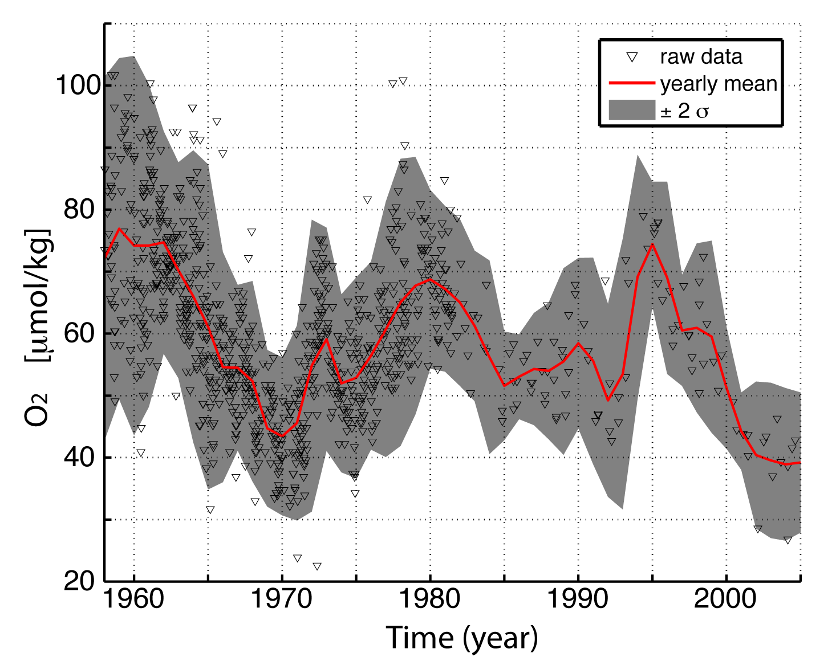
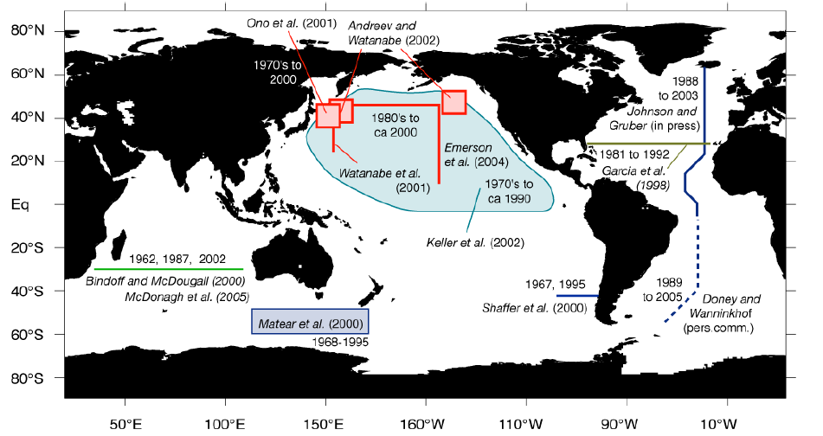
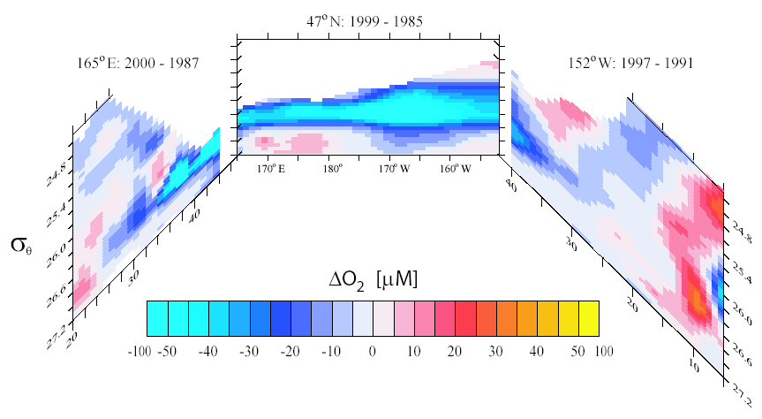
Global changes in oceanic O₂
A global change: “ocean deoxygenation”
Gruber et al. (2007)
NPIW

Slide 14
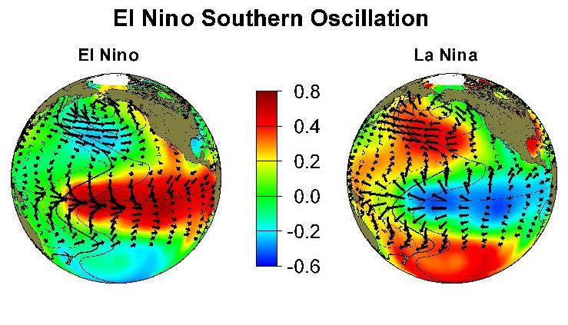
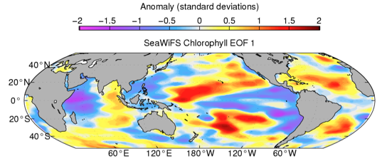
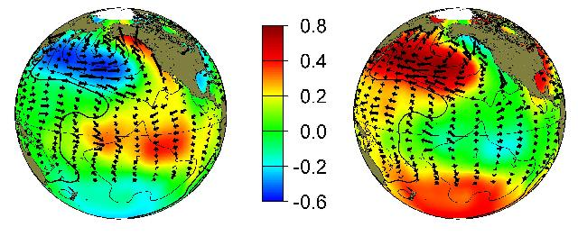
Impact of climate variability
Once every 2-8 years
PDO
Once every 25-40 years
Tropical Pacific
  Enhanced ocean color (chlorophyll) variability
  Size of OMZ is correlated with PDO (Deutsch et al 2011)

Slide 15
A conceptual model for sub-surface O₂
Air-sea gas exchange (O_{2,sfc}, set to a constant)
Ocean circulation (W)
O₂ loss by respiration (R)
Depth of the thermocline (H)

Slide 16
Steady solution
Long-term change can be explained by the steady state solution
  Set RHS = 0 and solve for O₂
Decreasing oxygen can be explained by
  Increasing sea surface temperature (smaller O_{2,sfc})
  Increasing biological O₂ consumption (R)
  Decreasing transport supply of O₂ (W)

Slide 17
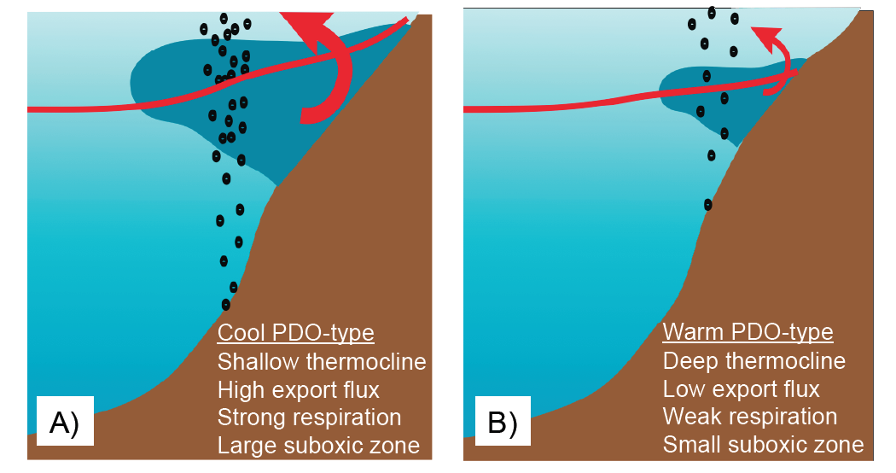
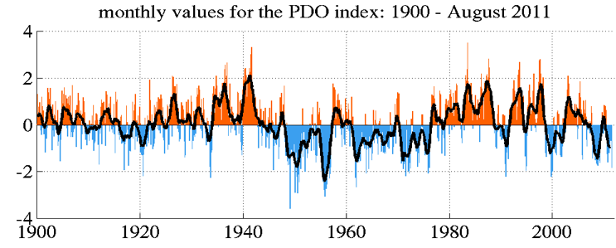
A possible mechanism for PDO-O₂ relationship
+PDO and high O₂
-PDO and low O₂
Deutsch et al (2011)

Slide 18
Summary
Yin & Yang: CO₂ and O₂ often show opposite tendency
  Photosynthesis and respiration
  “Aging” of ocean water masses
What can O₂ tell us about climate and oceans?
  Multiple controls: T, circulation and biology
  Global de-oxygenation?
  Modes of climate variability?

